Slide 1

Robot Operating system
Basics of ROS
Lecturer: Dr. Bui Ha Duc
Dept. of Mechatronics
Email: ducbh@hcmute.edu.vn

Slide 2
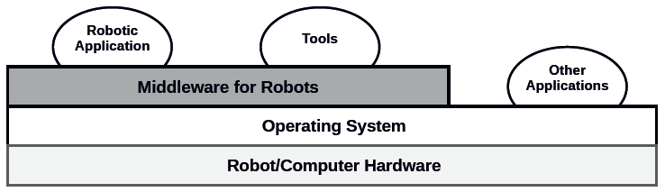
Introduction
Robot middleware frameworks:
Robot programming middleware provide:
drivers, libraries, tools and methodologies
YARP, URBI,
Player/Stage

Slide 3
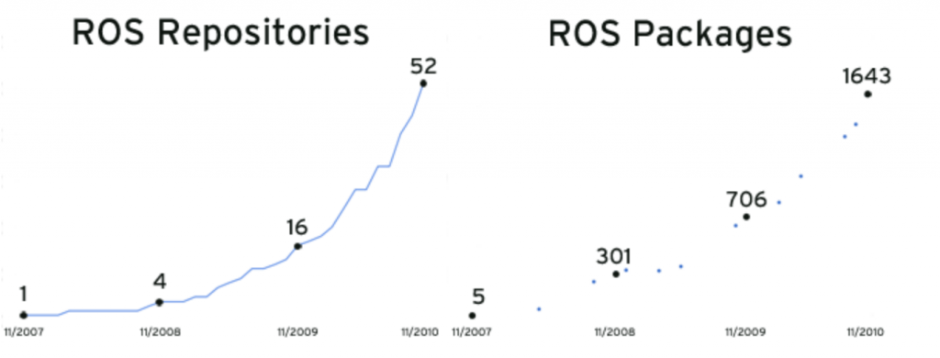
Introduction
History of ROS (https://www.theconstructsim.com/history-ros/)
Initiate by Standford University in May-2007
In Nov-2007, Willow Garage take the lead
After the close of Willow Garage in 2014, ROS becomes an open source framework
https_www.businessinsider.com/?url=https%3A%2F%2Fwww.businessinsider.com%2Fa-look-back-at-willow-garage-2016-2

Slide 4

Introduction
ROS is an open source framework for robot control
ROS serve as a common software platform for people who are building and using robot
  Share code and ideas
  Contain many software packages → save time
Hardware Control
GUI tools
Computational Infrastructurre
Robotics algorithms
ROS
Simulation
Graphic user interface
Data logging
Process management
Inter-process communication
Device drivers
Control
Planning
Mapping
Perception
Package organization
Software distribution
Documentation
Tutorial
Notes:
1. A set of drivers that let you read data from sensors and send commands to motors and other actuators, in an abstracted, well-defined format. A wide variety of popular hardware is supported, including a growing number of commercially available robot systems.
2. A large and growing collection of fundamental robotics algorithms that allow you to build maps of the world, navigate around it, represent and interpret sensor data, plan motions, manipulate objects, and do a lot of other stuff. ROS has become very popular in the robotics research community, and a lot of cutting-edge algorithms are
now available in ROS.
3. All of the computational infrastructure that allows you to move data around, to connect the various components of a complex robot system, and to incorporate your
own algorithms. ROS is inherently distributed and allows you to split the workload across multiple computers seamlessly.
4. A large set of tools that make it easy to visualize the state of the robot and the algorithms, debug faulty behaviors, and record sensor data. Debugging robot
software is notoriously difficult, and this rich set of tools is one of the things that make ROS as powerful as it is.

Slide 5
ROS philosophy
Peer-to-Peer: individual packages communicate over defined API
Network: Multiple computer can run and communicate over the network
Multi-Language: ROS module can be written and multiple languages (C++, Python, Matlab, Java…)
Thin: stand-alone libraries are build inside ROS layer
Free and open source

Slide 6
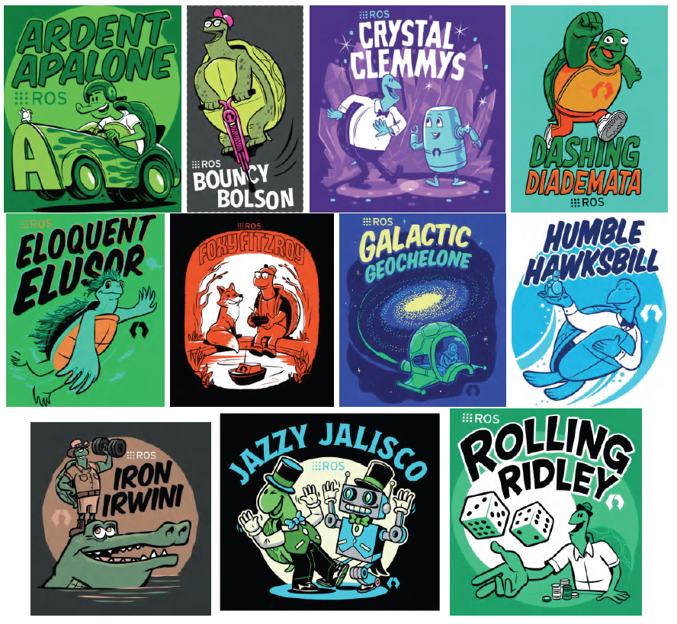
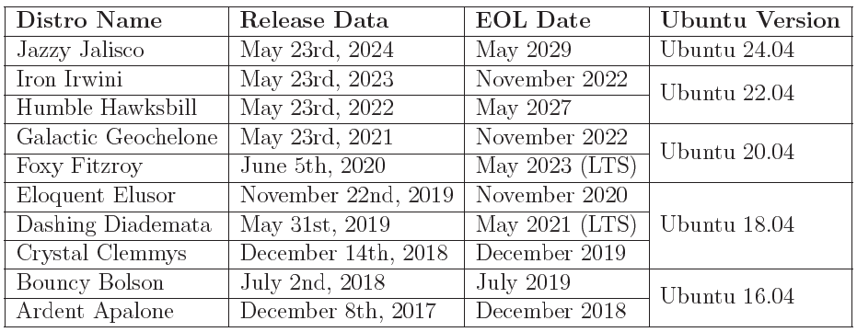
Introduction
Website:
http://www.ros.org/
ROS2 Documentation:
https://docs.ros.org

Slide 7
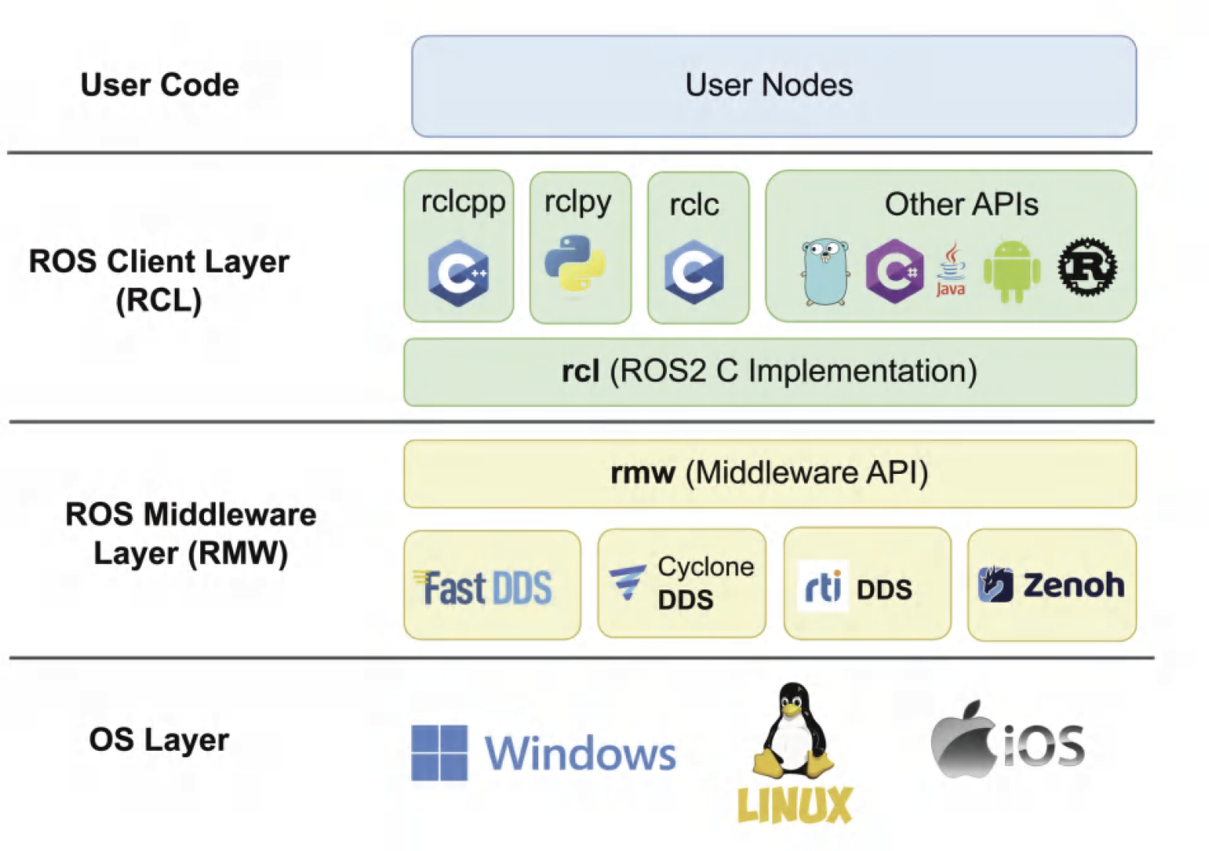
ROS2 Architecture

Slide 8
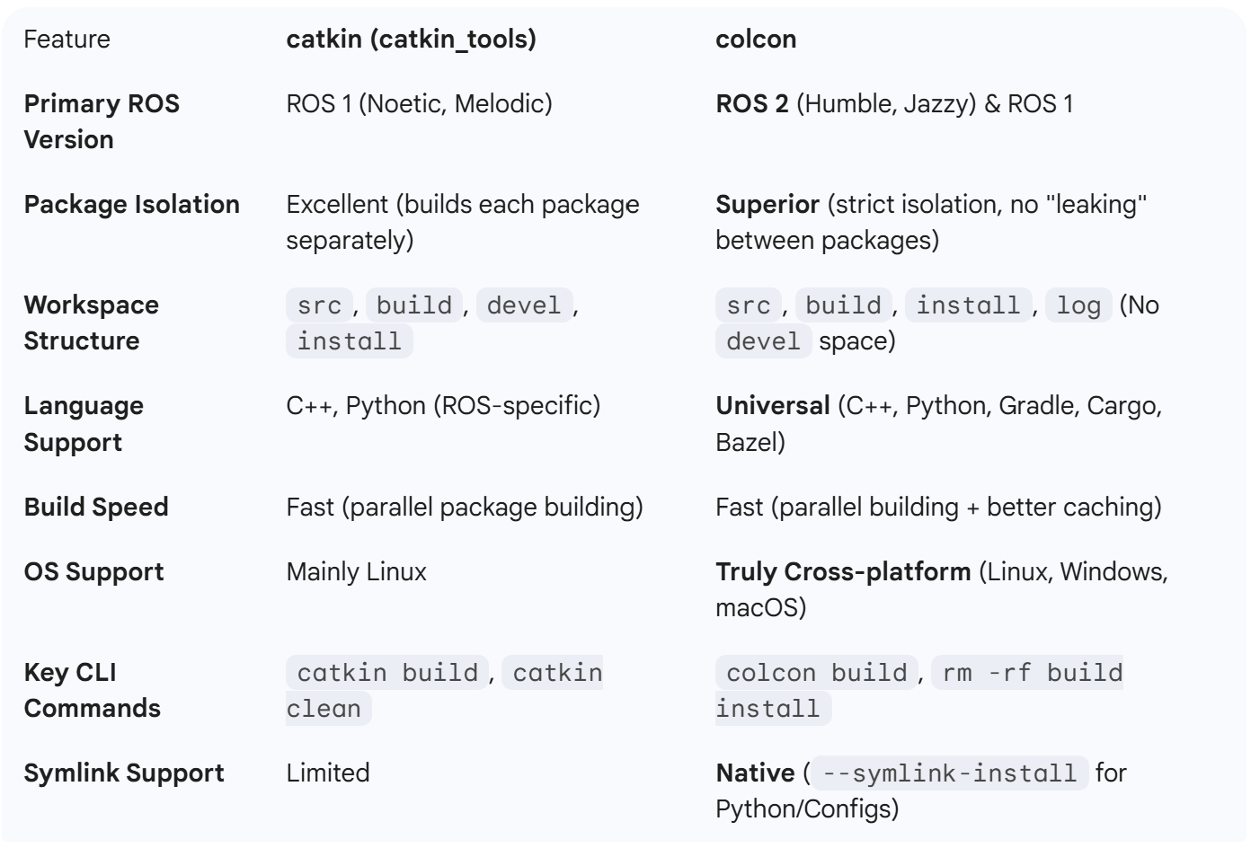
ROS Build System
ROS build system is responsible for generating executables, libraries and interface from raw independent source code – packages
"shortcut" for your file
Notes:
ROS is a very large collection of loosely federated packages. That means lots of independent packages which depend on each other, utilize various programming languages, tools, and code organization conventions. Because of this, the build process for a target in some package may be completely different from the way another target is built. catkin specifically tries to improve development on large sets of related packages in a consistent and conventional way.
Multi-language support

Slide 9
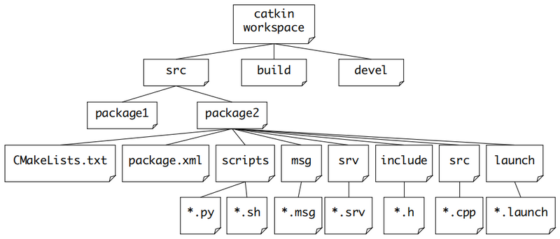

ROS Workspace
ROS Workspace is a dedicated directory where you develop, store, and build your robotics software.
install
logs
src
The source space contains source code for packages
build
Where CMake used to build the packages contained in src folder
devel
Developmental space where built targets are placed before being installed
Install
Contains the final executables and setup scripts.
Install
Contains detailed logs of the build process.
Work here
Don’t touch
ROS 2 Workspace
ROS 1 Workspace

Slide 10
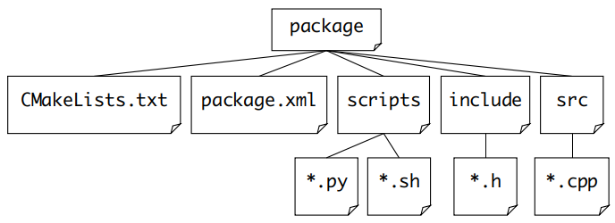
ROS Package
Inside your src directory, you will have multiple package folders
Package is the basic cell of ROS
Set rules for compilation
Note: Python package create setup.py instead of CMakeList.txt
Source Code
Defines the properties of package: dependencies, version, authors…
Notes:
When we execute the catkin_make instruction, the compilation system will look for the package executable package one by one.

Slide 11
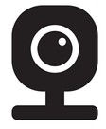
Create 1st ROS package
Node Camera_opencv
Topic /camera/image_raw
Create a ROS package that:
  Reads frames from a camera using OpenCV
  Publishes them as sensor_msgs/Image
  Sends them to a topic (e.g. /camera/image_raw)
Use python as the main language

Slide 12
Create 1st ROS package
Step1: Create package
Move to /ros2_ws/src folder
cd ~/ros2_ws/src
Create a new package
ros2 pkg create camera_opencv --build-type ament_python --dependencies rclpy sensor_msgs cv_bridge

Slide 13
Create 1st ROS package
ros2 pkg create camera_opencv
ros2 pkg create : Create a new ROS 2 package with the standard structure
camera_opencv : Package name.
Package name should be lowercase, unique in the workspace
Package name will be used when building, running (e.g. ros2 run camera_opencv)
--build-type ament_python
This tells ROS 2 which build system and language you want.
  ament_python → Python
  ament_cmake → C++
  ament_cmake_python → hybrid
--dependencies rclpy sensor_msgs cv_bridge
This line declares ROS 2 dependencies
These dependencies will be written into package.xml automatically, you can modify it later

Slide 14
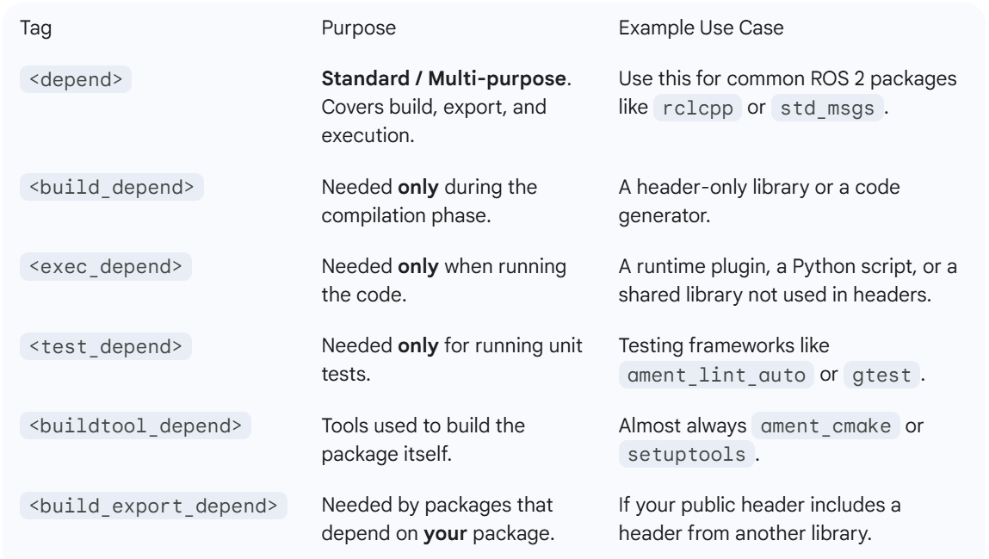
ROS2 Dependencies
Dependencies are other software packages (libraries, tools, or ROS nodes) that your package needs to function
The package.xml define how a dependency is used

Slide 15
ROS2 Dependencies
There are thousands of dependencies available.
Common dependencies:
Client libraries:
  rclcpp: The C++ client library. Can not write a C++ ROS 2 node without it.
  rclpy: The Python client library. Can not write a python ROS 2 node without it.
Message Interfaces:
  std_msgs: Simple types like String, Int32, Float64, and Bool.
  geometry_msgs: Essential for any robot that moves. Includes Twist (for velocity), Pose (for position), and Transform.
  sensor_msgs: Standard data for hardware like Image, LIDAR, IMU, and PointCloud.
  nav2_msgs: Navigation2 message for robot moving

Slide 16
ROS2 Dependencies
Common dependencies:
Transformation & Math:
  tf2 / tf2_ros: The library used to keep track of coordinate frames
  numpy: The Python library for math and array handling
  eigen: The C++ library for linear algebra and matrix math
Tools
  cv_bridge: The "bridge" between ROS image messages and OpenCV. ROS cannot understand OpenCV images directly

Slide 17
Create 1st ROS package
The package folder structure:
camera_opencv/
├── camera_opencv/
│ └── __init__.py
├── resource/
│ └── camera_opencv
├── package.xml ← dependencies are listed here
├── setup.py ← Python build config
├── setup.cfg
└── test/

Slide 18
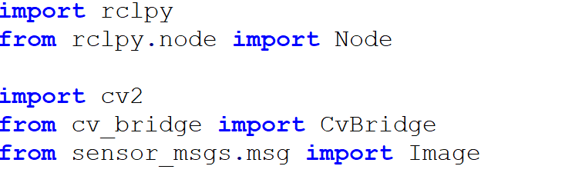
Create 1st ROS package
Step 2: Write source code for a node
Create a new file in camera_opencv folder
touch camera_opencv/camera_opencv/camera_publisher.py
Write code

Slide 19
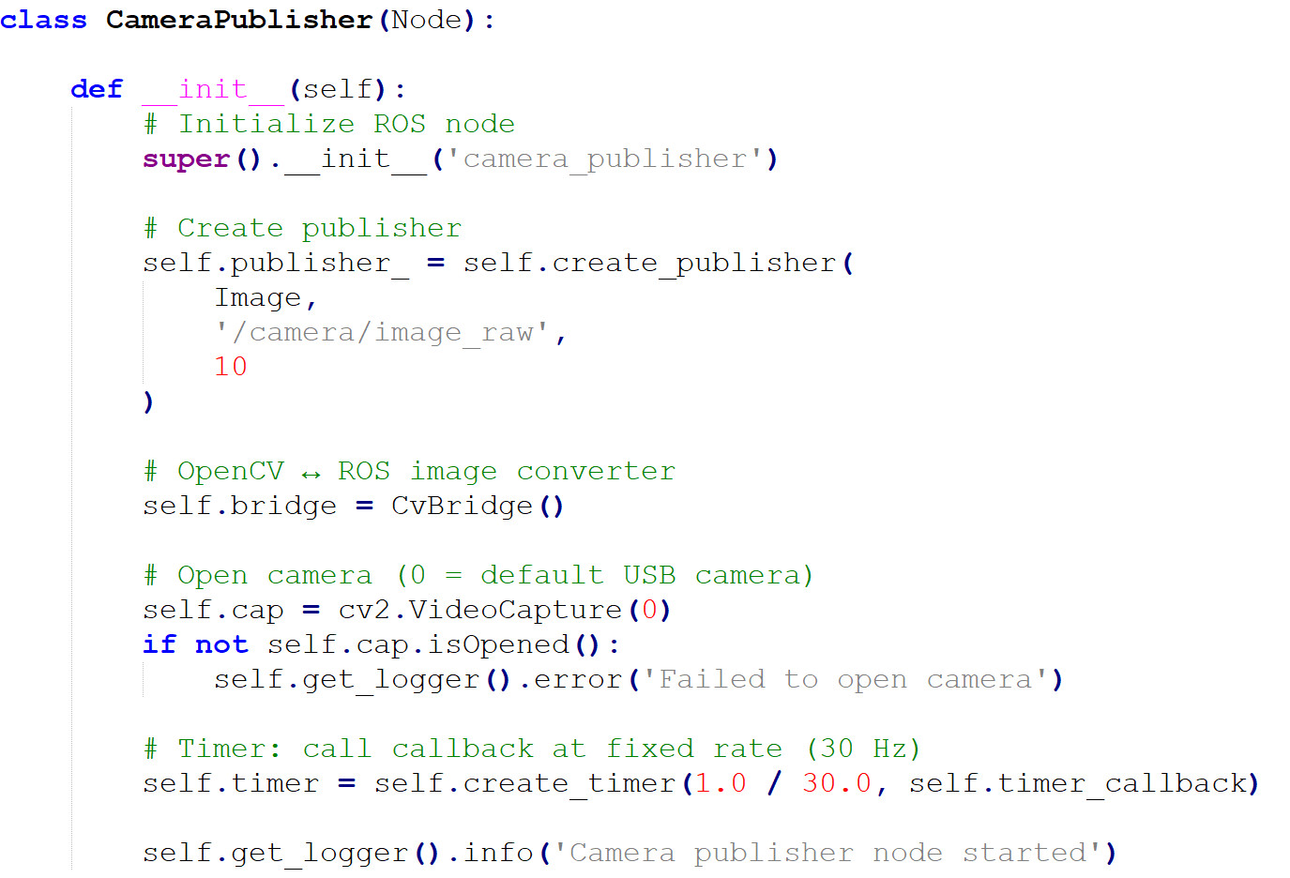
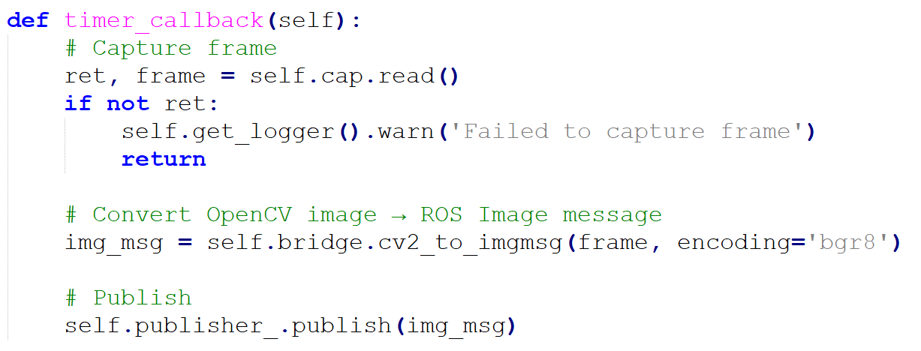
Create 1st ROS package

Slide 20
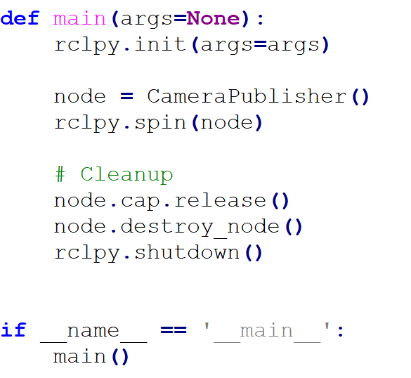
Create 1st ROS package

Slide 21
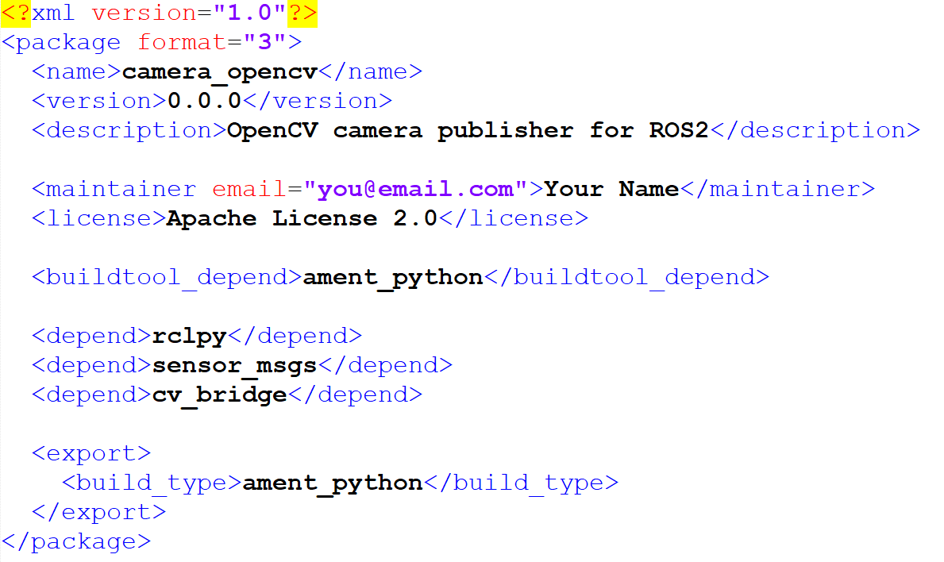
Create 1st ROS package
Step 4: Edit package.xml and setup.py
package.xml tells ROS what this package is, what it depends on, and how it fits into the ROS ecosystem
ROS errors often point to package.xml

Slide 22
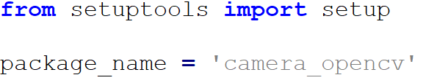
Create 1st ROS package
Step 4: Edit package.xml and setup.py
setup.py tells Python and ROS2 how to install and execute your Python code as ROS 2 nodes
setup – python standard library used to define how a Python package is built, installed, and organized
Key arguments of setup():
  packages - Lists the directories containing your code
  data_files - Tells ROS where to put non-code files
  install_requires - Lists non-ROS Python dependencies
  entry_points - maps a “node name" to a specific "function" in your code

Slide 23
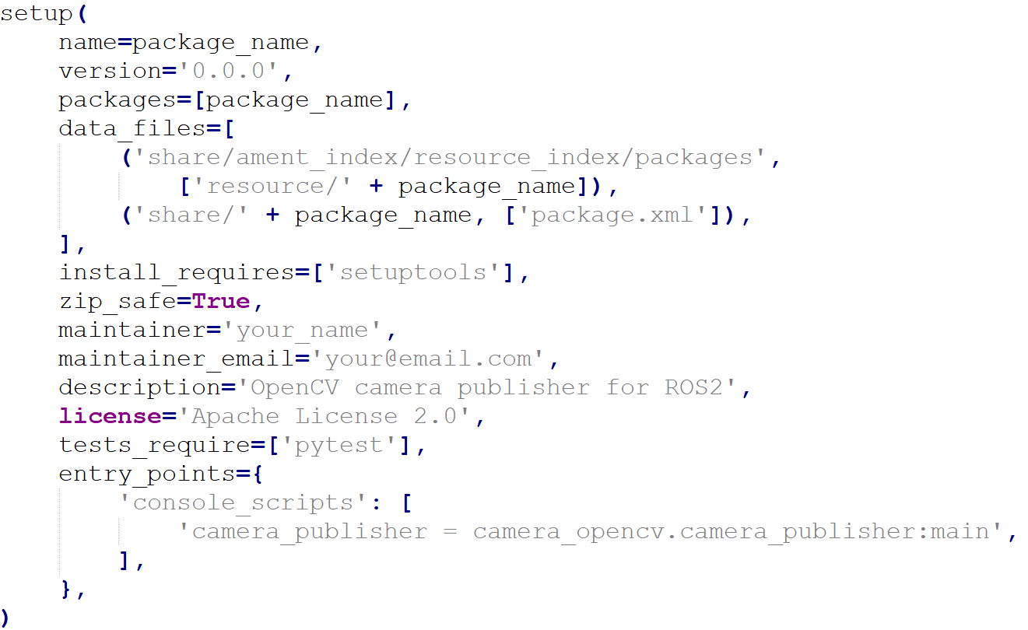
Create 1st ROS package

Slide 24
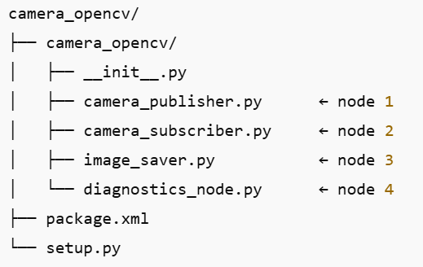
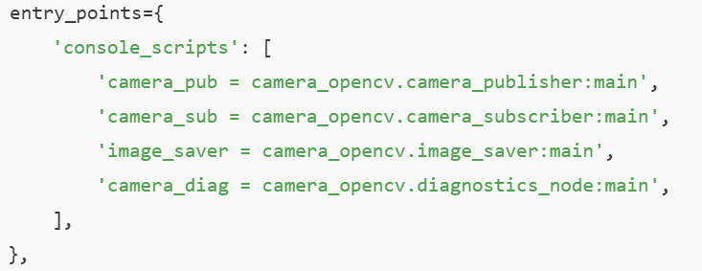
Create 1st ROS package
One ROS2 package can contain many nodes
Run them independently:
ros2 run camera_opencv camera_pub
ros2 run camera_opencv camera_sub
setup.py

Slide 25
Create 1st ROS package
Step 5: Build the package
Build command:
colcon build
What actually happens:
ROS reads package.xml
Use ament_python to build your code
Hands control to Python setuptools
Run setup.py to installs your package, registers console scripts and places files in folder install/

Slide 26
Create 1st ROS package
Run the node
ros2 run package_name executable_name
e.g:
ros2 run camera_opencv camera_publisher

Slide 27
Excercise

